Slide 1
Section 9.4 Solving Problems Involving Volumes

Slide 2
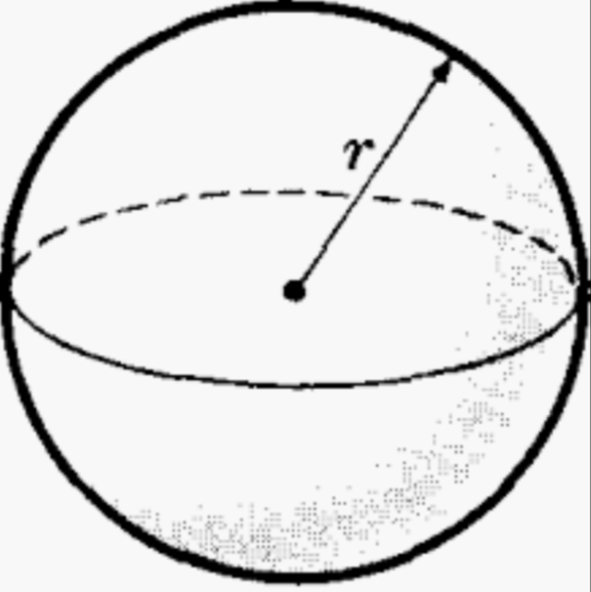
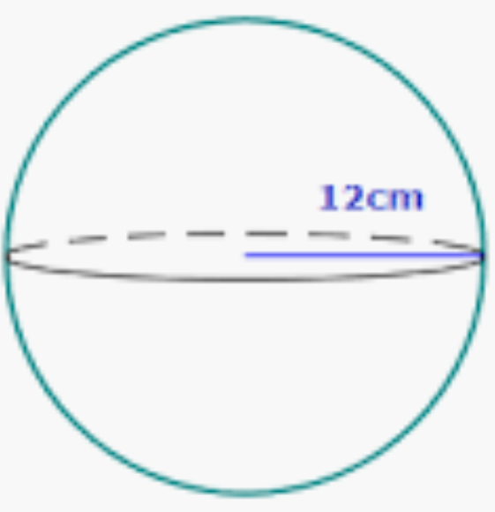
Volume of a Sphere:
A sphere is a ball shaped solid with a radius of “r”
Ex: What is the volume of this sphere?
Step 1: find the radius
r =12cm

Slide 3
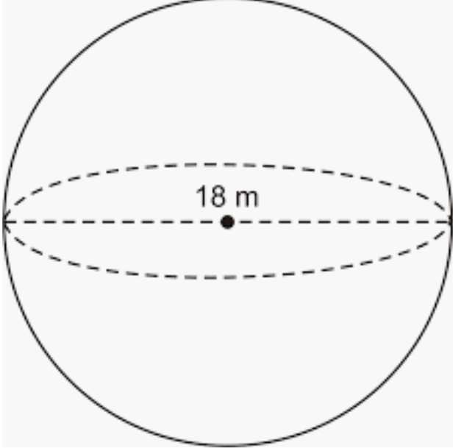
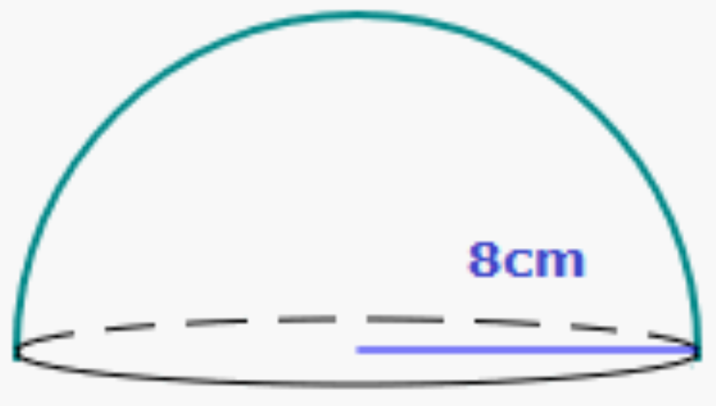
Practice: Find the volume of the following solids
Only the diameter is given. So to find the radius, divide the diameter by 2
This is a hemisphere, meaning it’s half a sphere. So the formula will be slightly different
Plug the radius into the formula for volume of sphere:
Since it’s a sphere cut in half, we divide the volume by 2

Slide 4
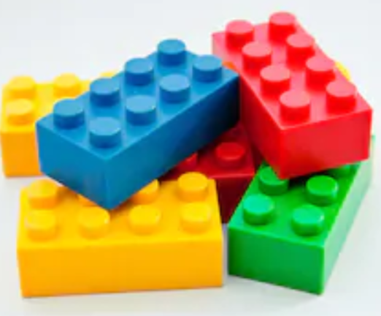
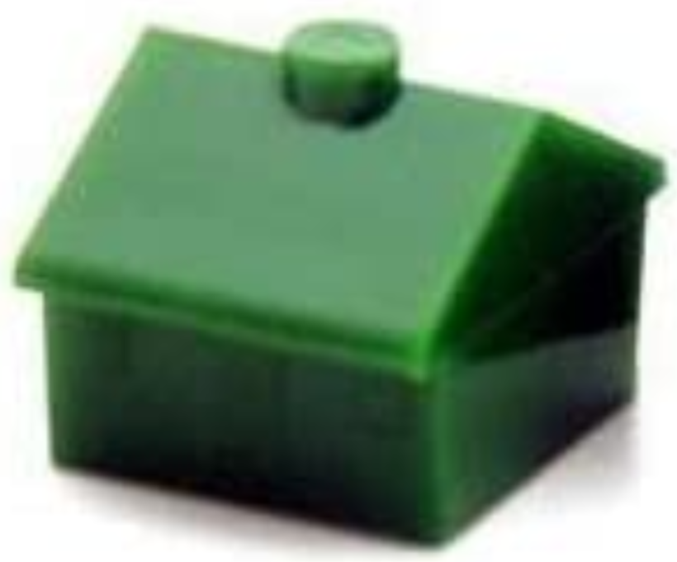
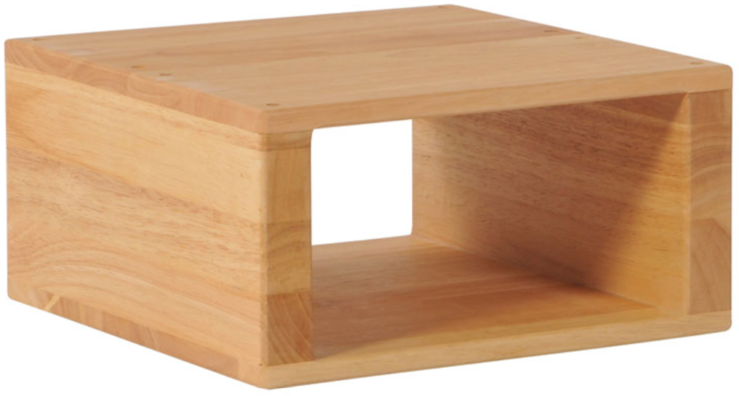
ii) Composite Solids
A composite solid is a shape that is a combination of two or more solids combined together
You see it everywhere: toys, buildings, furniture….etc.
Rectangular Prism +
4 Cylinders
Rectangular Prism +
Triangular Prism +
Cylinder at top
Big Rectangular Prism – small rectangular Prism

Slide 5
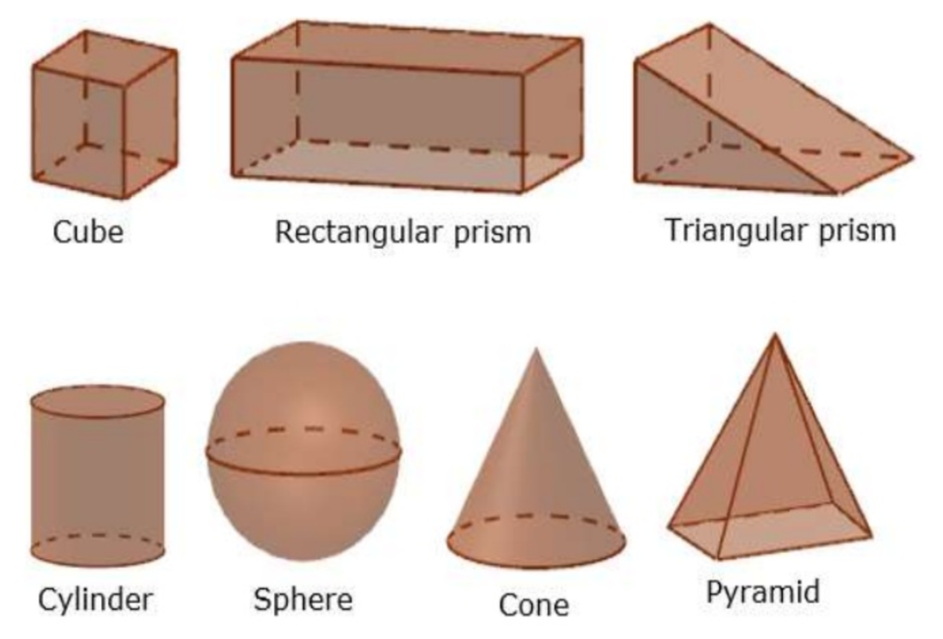
Names of General 3D Solids:

Slide 6
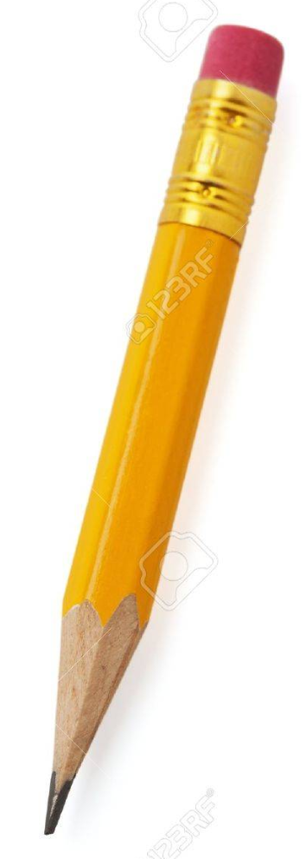
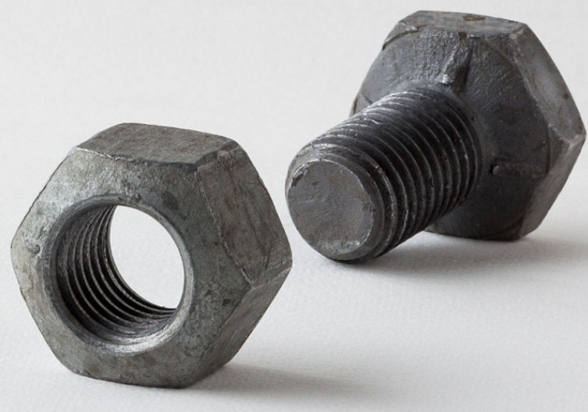
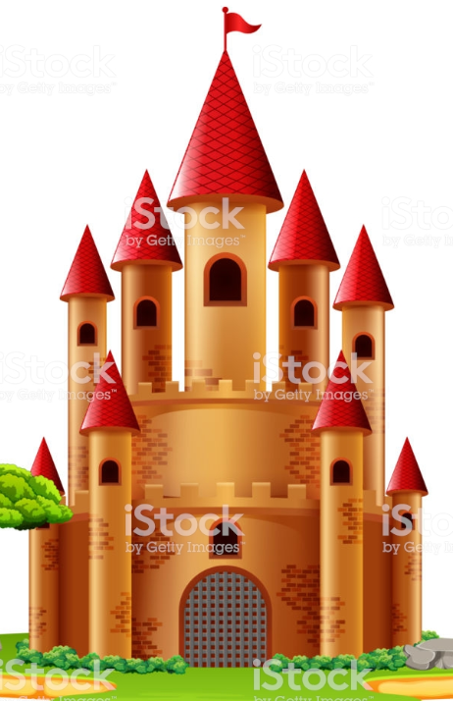
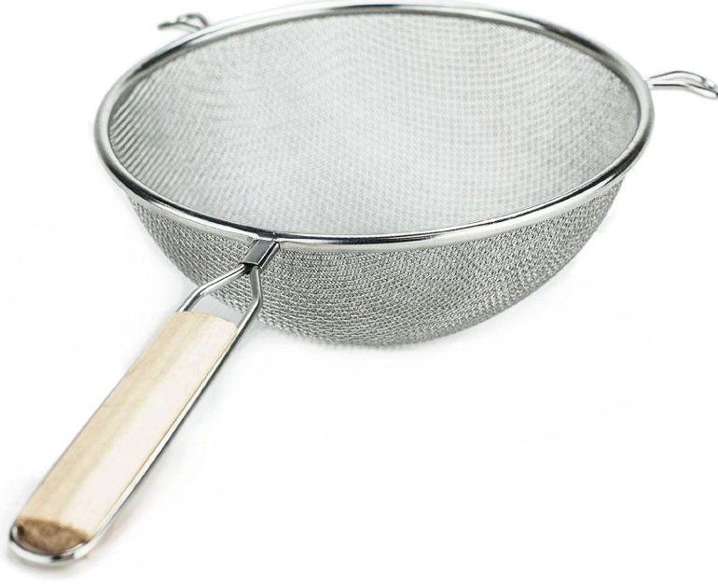
Given each object on the left, indicate which solids it is combined of:
Cylinder + Cone
Bolt: Hexagonal Prism - cylinder
Screw: Hexagonal Prism + cylinder
Cones + Cylinders
Hemisphere + rectangular prism

Slide 7
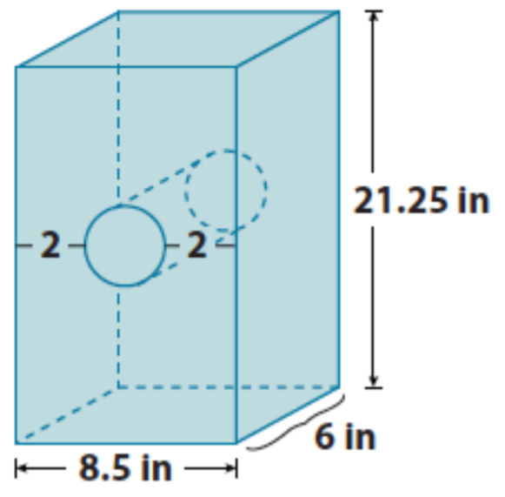
Practice Find the Volume of the following Solids:
This shape is a rectangular prism - cylinder
This shape is a triangular prism + rectangular prism
Copyright All Rights Reserved Homework Depot at www.BCMath.ca

Slide 8
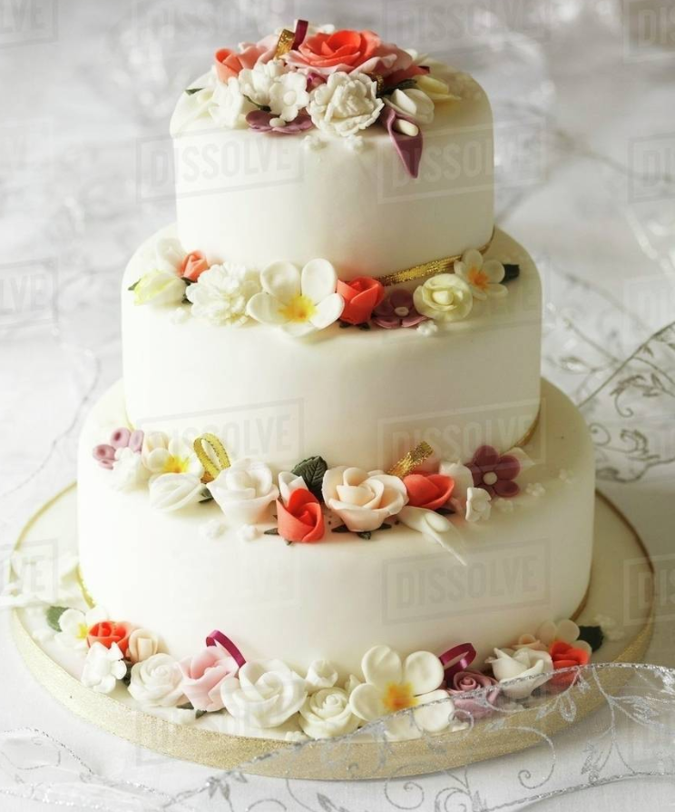
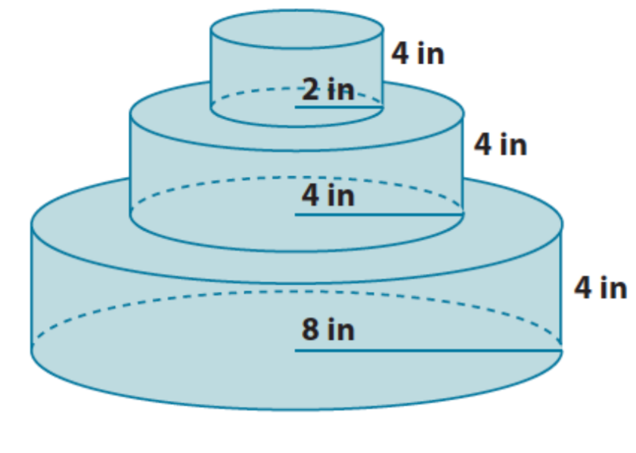
Find the volume of this wedding cake:

Slide 9
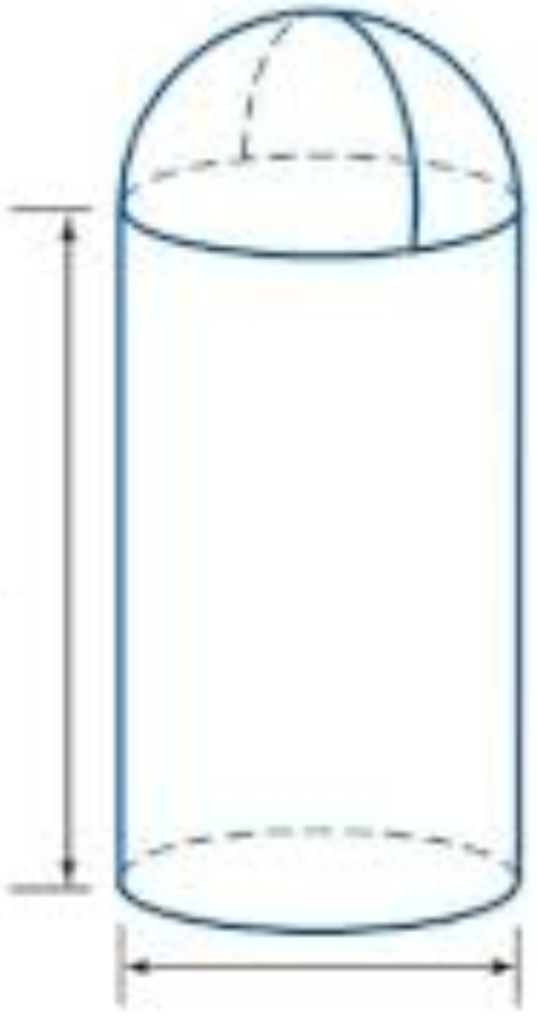
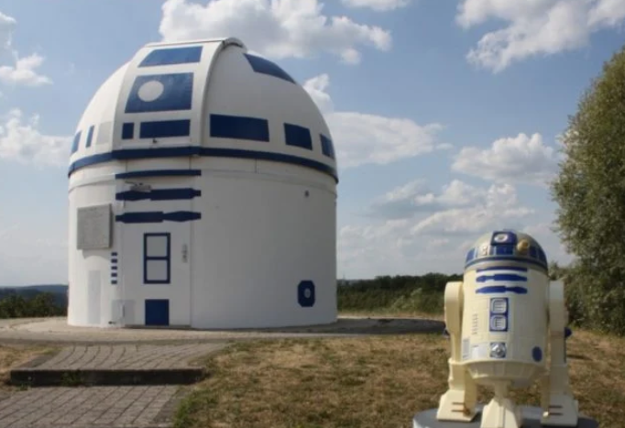
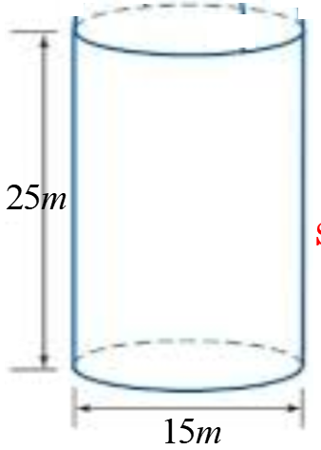
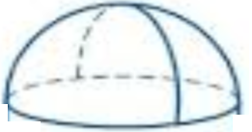
Ex: Given the dimensions of this observatory, what is the volume of the building?
Shape: Cylinder + Hemisphere

